Slide 1
Understand the Customer

Slide 2
Customer Engagement
Customer Analysis
Corporate Vision of CEO, Board
Goals of CxO
Needs of Department
Pains of workers
Notes:
Write down the corporate vision and mission statement. What are the CEO’s plans for the next year? Read the website. If the company is publically listed in the USA, read the business risks in their SEC quarterly reports.
Expect your sales colleagues to have done this deep analyse and be able to itemize and prioritize the goals, needs and pains.

Slide 3
Customer Qualification
(Executive) Vision – why the company exists, purpose, mission
Simplify, best in field, best services, innovate, sustainability, social responsibility
What is the corporate vision on the website?
(Operational) Goals - what they want to do
Improving speed, quality, service, growth, efficiency, market position, trust, creative,
“Automate”, transparency, customer satisfaction, prioritize
Save money, create value
(Departmental) Needs - what they need to do to achieve a goal
Comply, digitize, migrate, simplify, integrate, secure, retrieve, uptime, track, coordinate, streamline, “touchless”, measure …, keep employees happy and content, failure is not an option. Accuracy (quality of data), tracking, time frames, creative, error handling, productivity
(Departmental) Pains - prevents them from reaching a goal.
What happens if we do nothing at all?
Slow, intransparent, lost, wrong, complaints, increasing costs, complex, wasteful, no resources, insecure data, time consuming, tedious
Bold = RPA
Notes:
Who’s job is this?? The Account Manager! Not the Sales Engineer!

Slide 4
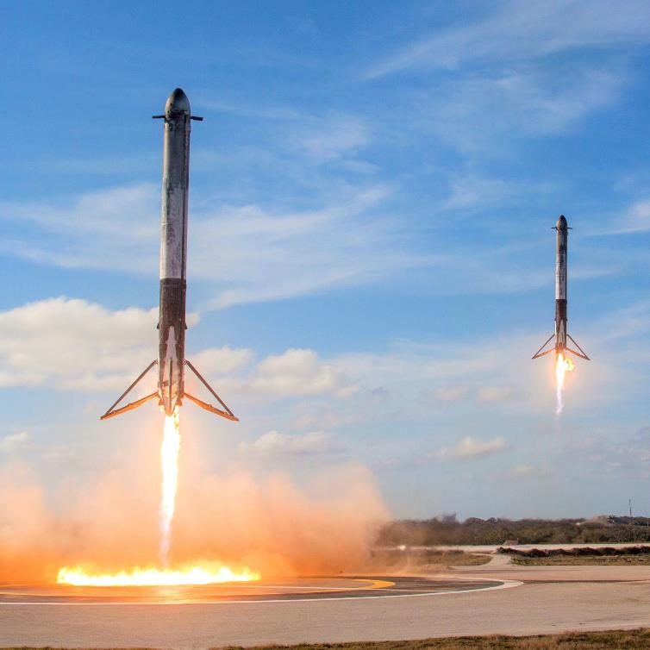
A hi-tech company
Corporate Vision
Making Humanity Multiplanetary.
Operational Goals
Make rockets reusable.
Departmental Needs
Build 40 boosters/year.
Departmental Pains
Director removed. Departments merged.
Quality Control on supplied components is a lot of paperwork. Software not keeping up.
IT
Solution too complicated to build. Need outside help.

Slide 5
Not-for-Profit Health Insurance Provider
Executive Vision
Provide premium member services
Living Well
Operation Goals
Get Fit
Retain members
Reduce costs of managing members
Reduce insurance leakage costs
Departmental Needs
Find member insurance information simply and quickly
Launch new products and services faster
Departmental Pains
Historical policies and acquisitions mean information is difficult to obtain
Legacy back end systems require high level of knowledge to use
6-9 months to launch new product

Slide 6
Petroleum Industry
Vision
Leader in transport fuels
Providing reliable, safe quality fuels to diverse market
Also providing retails services
Goals
operational excellence through safe, secure, reliable, efficient, incident-free and environmentally sound operations
capital stewardship by investing in the best project opportunities and executing them better than our strongest competitors
cost management by lowering unit-costs through innovation, technology and work-process improvements
Needs
Undertaking Operating Model Transformation to remain competitive in market place
Making changes to Enterprise Architecture to support future operating environment
Pains
Many legacy systems, many manual tasks that are time consuming
looking for operational efficiencies, to automate and reduce error rates

Slide 7
DMV – Customer Qualification
Vision Statement: DMV is a model state agency delivering exceptional customer service and promoting effective and efficient business processes, professional employees, innovative technology and strategic partnerships.
Goals:
Administer the State's motor vehicle licensing and titling laws by:
maintaining strict controls to deliver secure and valid identification, licenses, property records;
accurately account for the receipt and timely distribution of all revenue collected;
provide the best customer service for serve our citizens.
Values:
Competent, Committed, Courteous

Slide 8



Meet the buyers
Business
VP Operations (line of business), Chief Operating Officer, Chief Data Officer, VP Data Research, Global Process Owner, Director of Process Management, Director/VP of Shared Services, Director of Operational Excellence
Technical
VP/Director of IT, VP/Director of RPA Services
Influencer
CIO, Compliance Officer, Data Research Analyst, Operations Manager

